Slide 1
Datafest 2025
404 Brain Not Found

Slide 2
What affects rent the most?

Slide 3
First Approach - States

Slide 4
VARIABLES EXPLANATION
states
avg_
unemployment
count
total
overall_rent
The state from which the data is collected
Average unemployment rate
Number of Corporations owned Buildings in the dataset
Number of Buildings in the dataset
Annual Rent Fee per Square Foot

Slide 5
VARIABLES EXPLANATION
rate
cbd_rate
key_industry_rate
industries
Count / Total
Ratio of buildings occupied by corporations
Percentage of buildings in the city area
Percentage of Count occupied by core corporations
The dictionary that counts the number of each industry being used

Slide 6
What are in key_industry_rate?
key_industry_rate
Business(Consulting), Technology, Engineering, and Financial Services

Slide 7
VARIABLES FROM THE EXTERNAL SOURCES
Population.Change.Rate
Median.Household.Income
CPI
From U.S. Census Bureau
From Federal Reserve Bank of St. Louis
From U.S. Bureau of Labor Statistics

Slide 8
Data Explanation

Slide 9
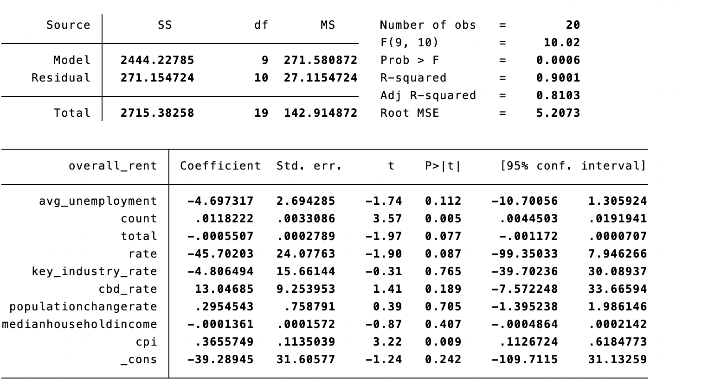
REGRESSION: overall_rent
Variables included:
avg_unemployment, count, total, rate, key_industry_rate, cbd_rate, population.change.rate, median.household.income, cpi

Slide 10
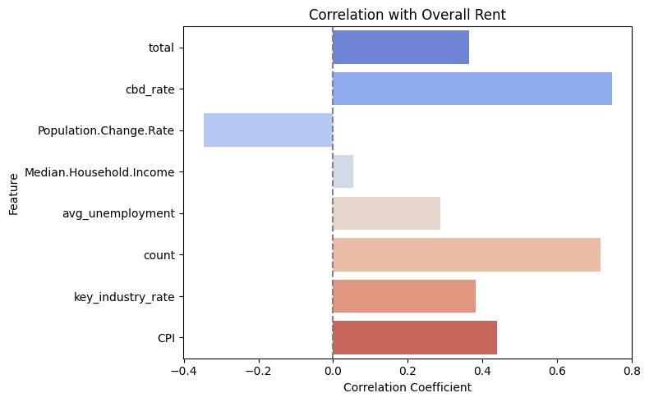
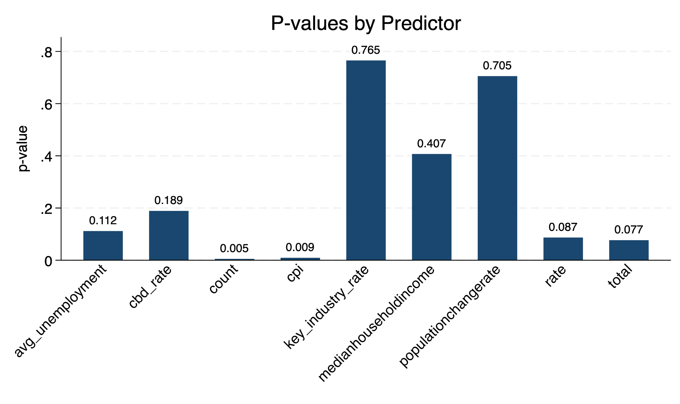
VISUALIZATION

Slide 11
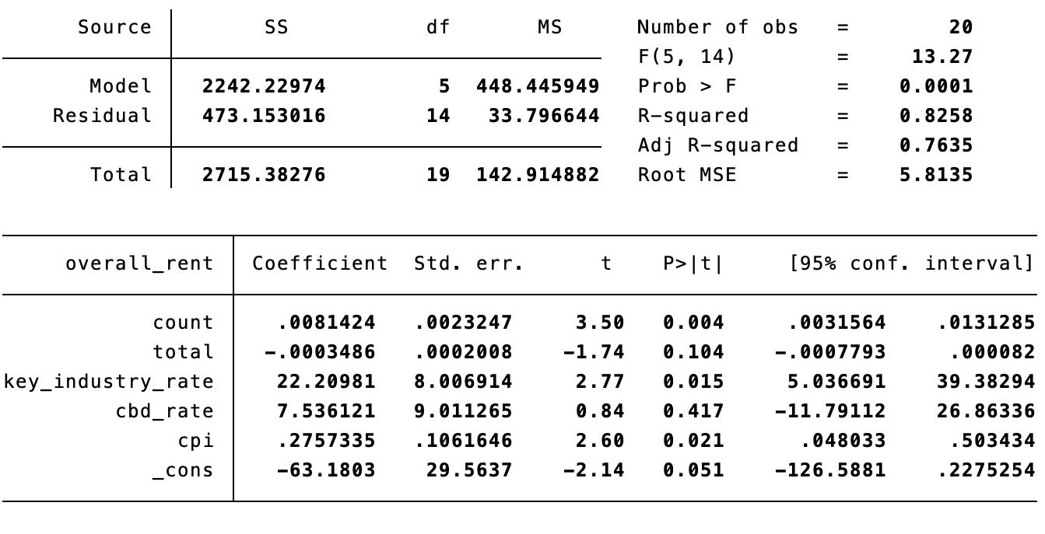
REGRESSION: overall_rent
Variables included:
count, total, key_industry_rate, cbd_rate, cpi

Slide 12
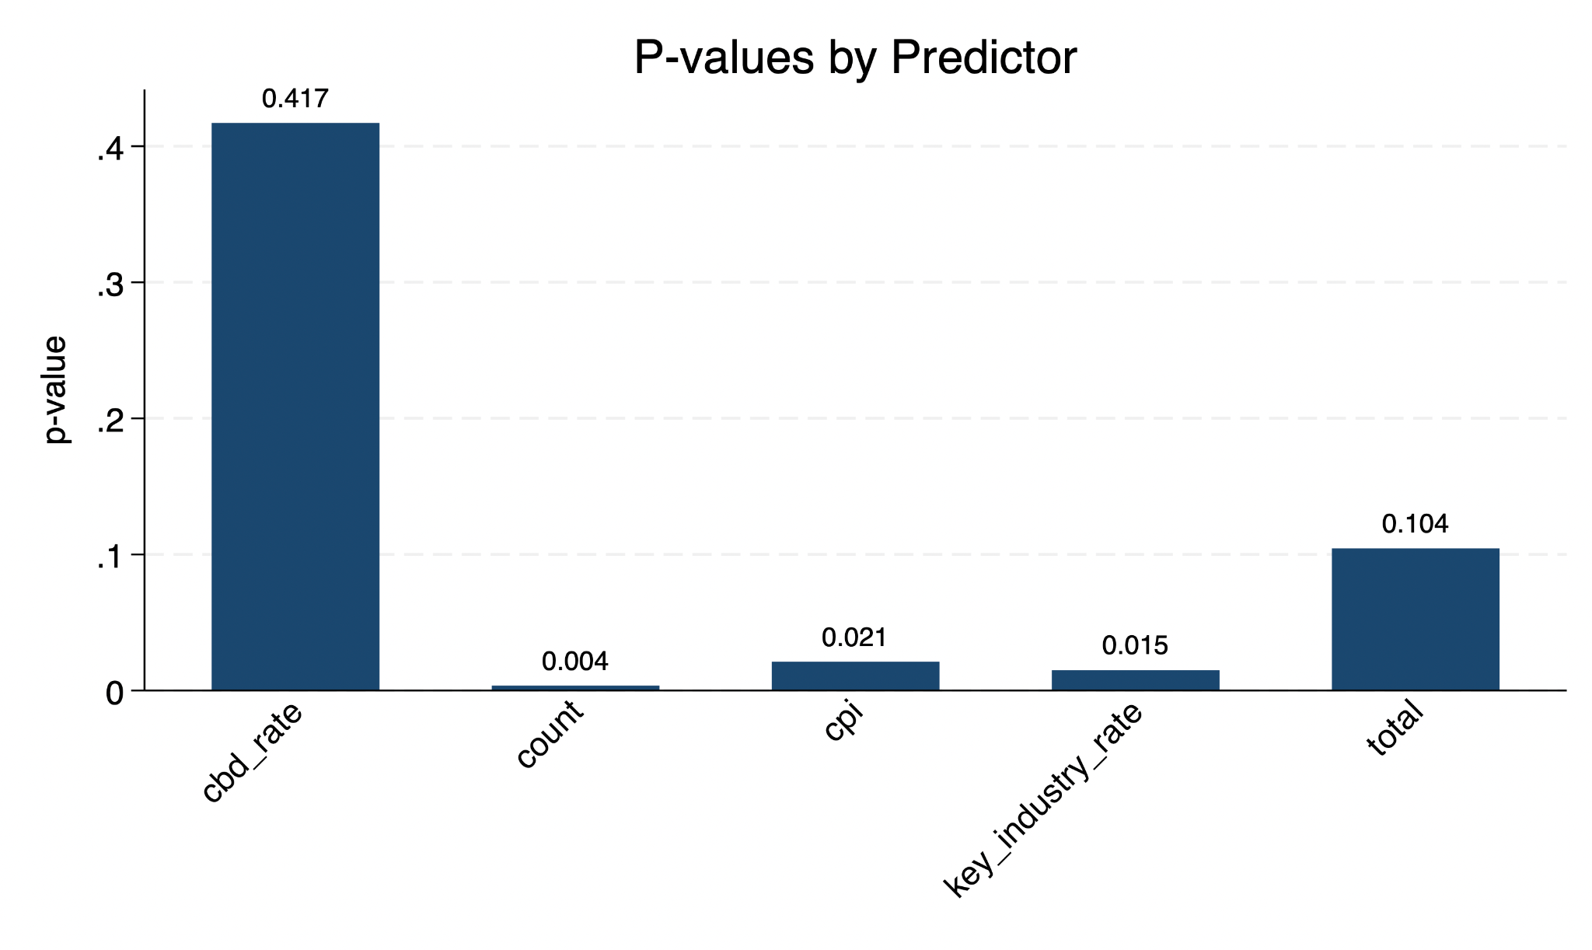
REGRESSION: overall_rent

Slide 13
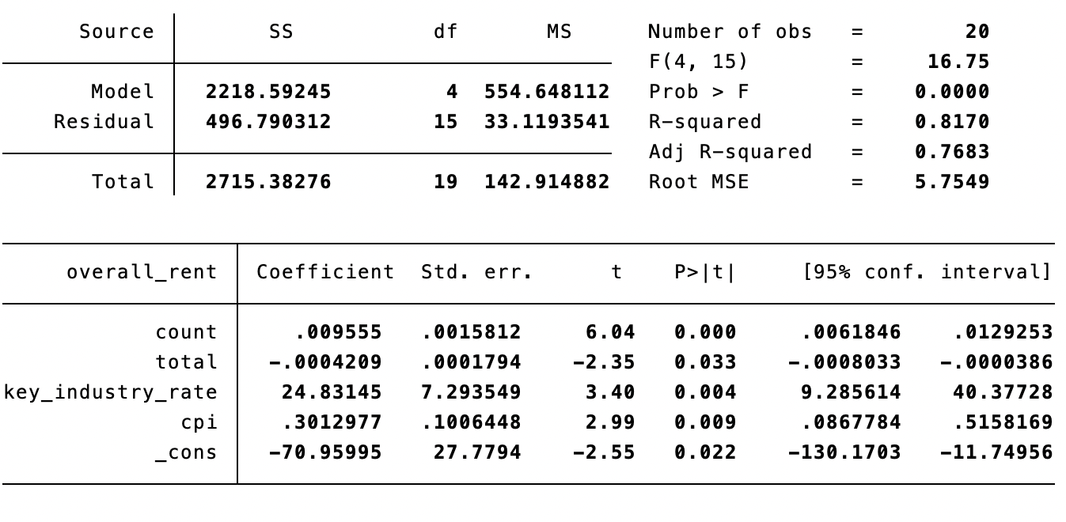
REGRESSION: overall_rent
Variables included:
count, total, key_industry_rate, cpi

Slide 14
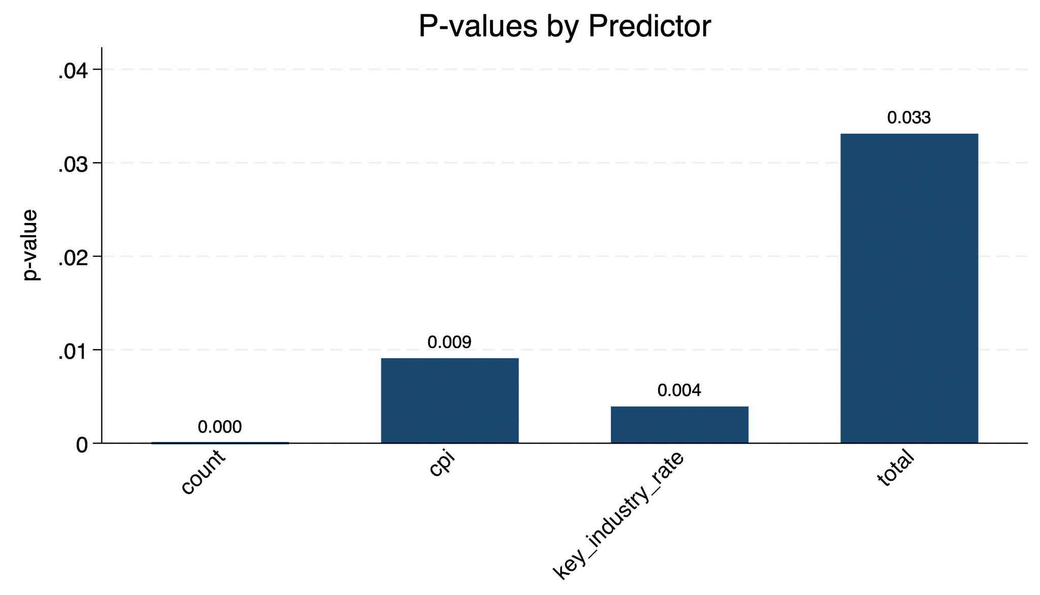
REGRESSION: overall_rent

Slide 15
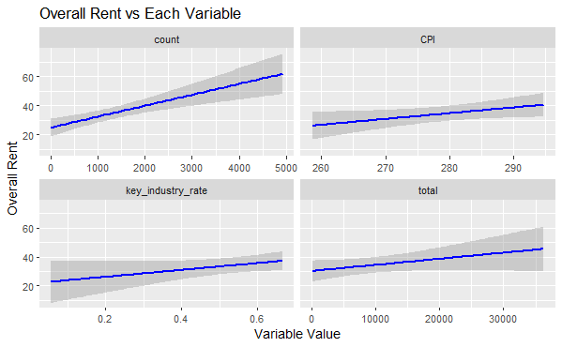
Conclusion

Slide 16
Second Approach - Zip code
(With Economic Variables)

Slide 17
VARIABLES EXPLANATION
zip
industries
count
total
overall_rent
The median ZIP code of the geographical cluster
The dictionary that counts the number of each industry being used
Number of Corporations owned Buildings in the dataset
Number of Buildings in the dataset
Annual Rent Fee per Square Foot

Slide 18
VARIABLES EXPLANATION
rate
key_industry_rate
rate
Count / Rate
Ratio of buildings occupied by corporations
Percentage of Count occupied by core corporations

Slide 19
VARIABLES FROM THE EXTERNAL SOURCES
CPI
From U.S. Bureau of Labor Statistics

Slide 20
Data Explanation

Slide 21
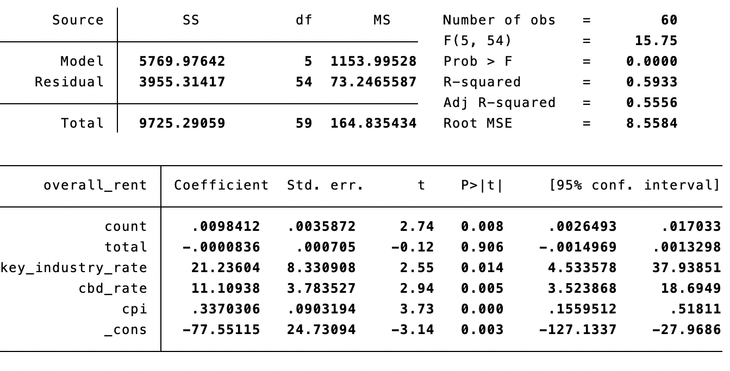
REGRESSION: overall_rent
Variables included:
count, total, key_industry_rate, cbd_rate, cpi

Slide 22
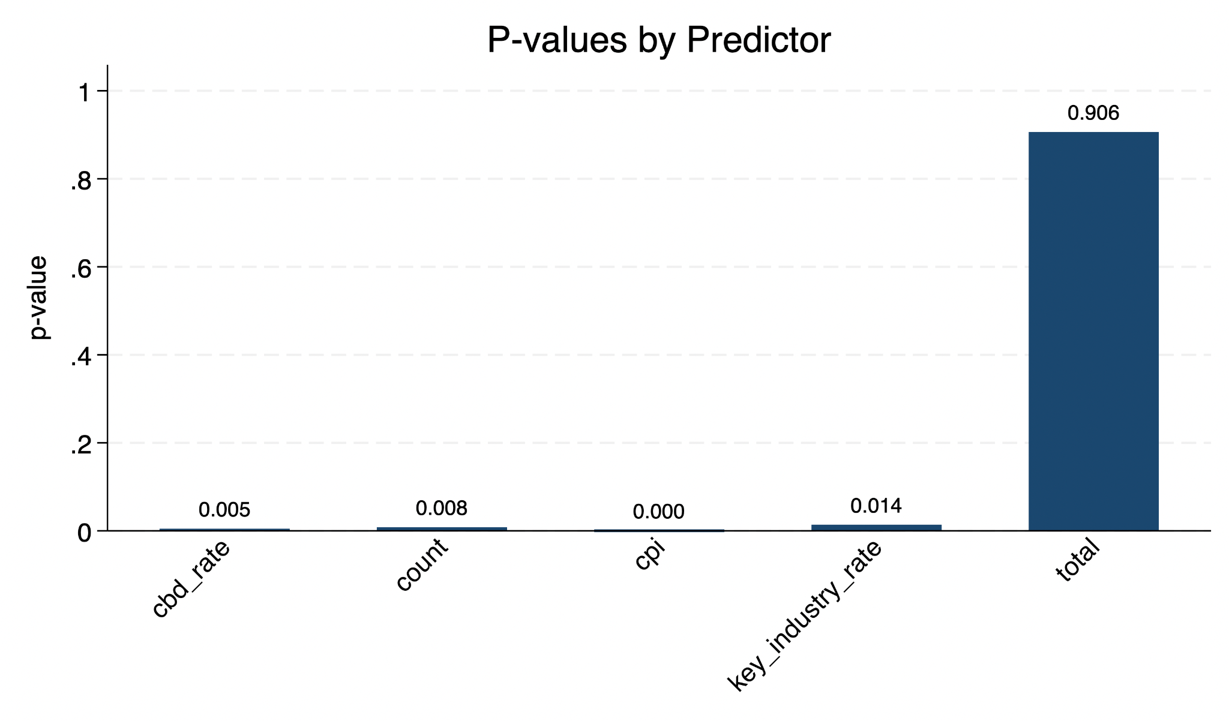
REGRESSION: overall_rent

Slide 23
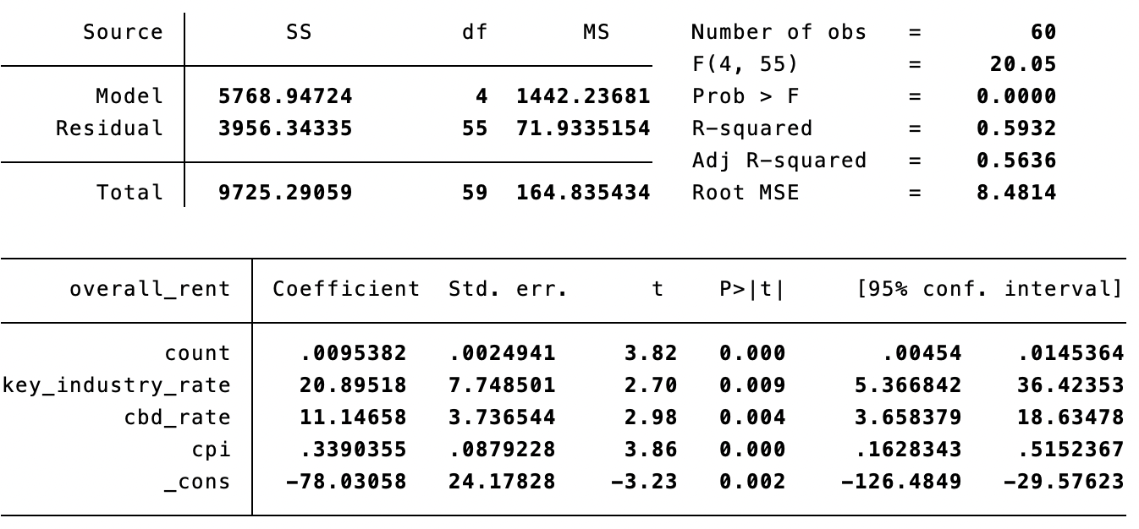
REGRESSION: overall_rent
Variables included:
count, key_industry_rate, cbd_rate, cpi

Slide 24
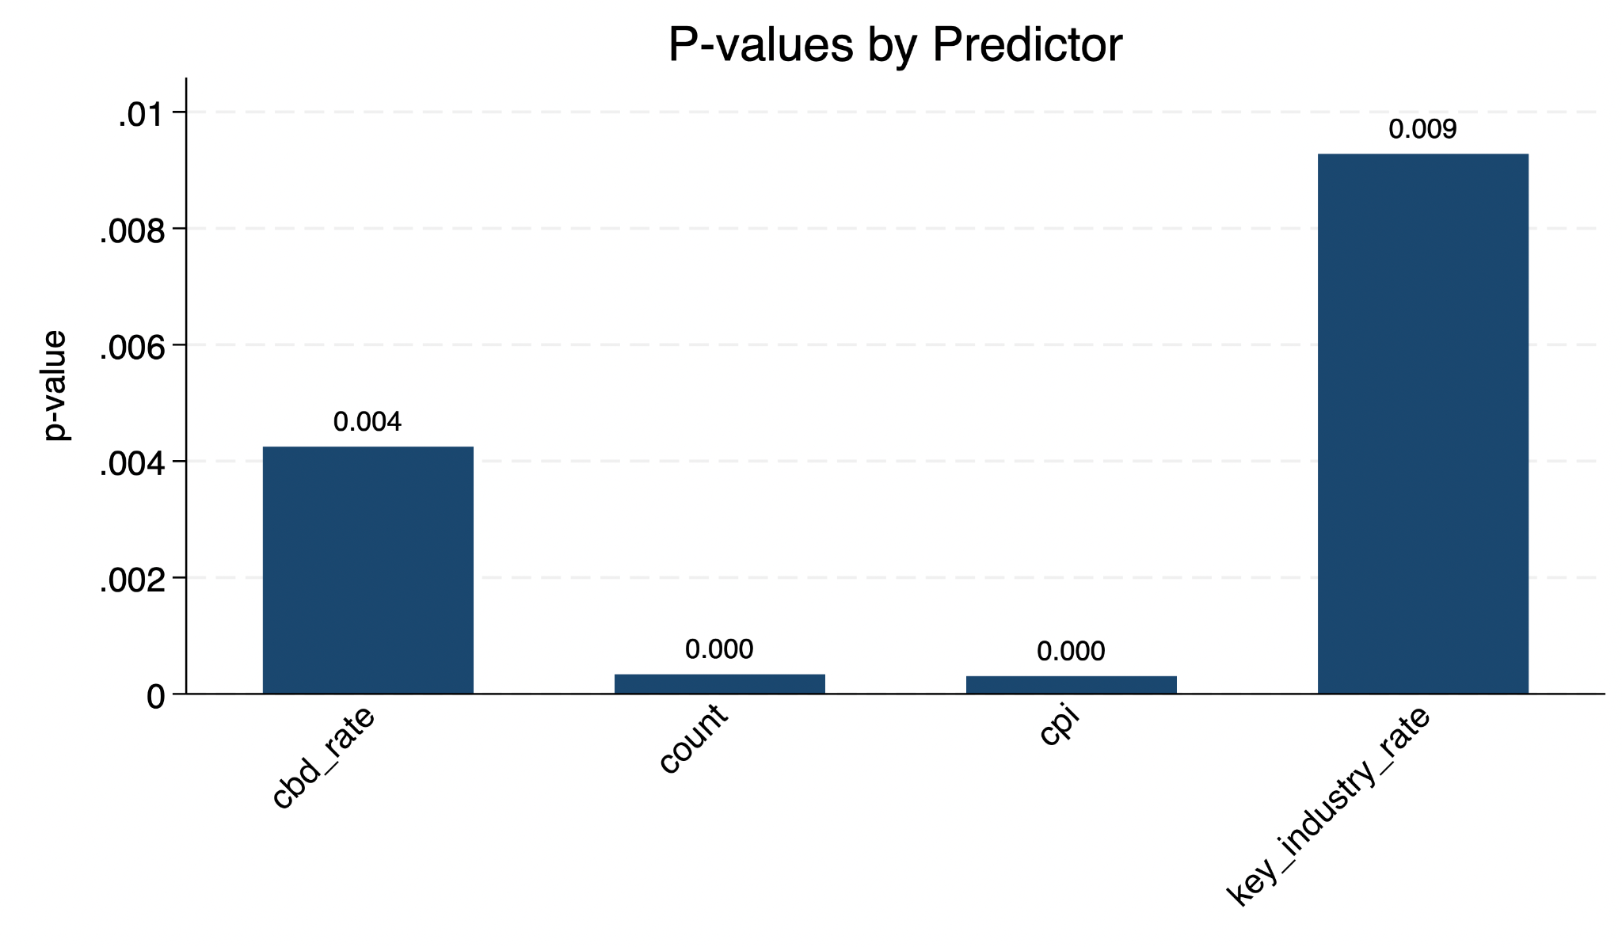
REGRESSION: overall_rent

Slide 25
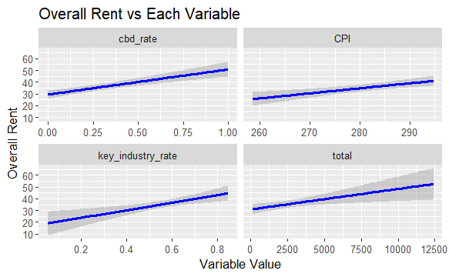
Conclusion

Slide 26
Last Approach - Quality of Life
With Non-economic Variables

Slide 27
VARIABLE EXPLANATION
cbd_rate
overall_rent
class_A_rate
Percentage of buildings in the city area relative to the total number of buildings
Annual Rent Fee
Per Square Foot
The quality of buildings

Slide 28
VARIABLES FROM THE EXTERNAL SOURCES
crime_score
pop_density
retail.score
health.value
education
From FBI
From statsamerica and statesymbolsusa
From Kaggle
From America’s Health
Rankings
From WalletHub

Slide 29
VARIABLES FROM THE EXTERNAL SOURCES
Population.Change.Rate
Median.Household.Rate
From U.S. Census Bureau
From Federal Reserve Bank of St. Louis

Slide 30
Data Explanation

Slide 31
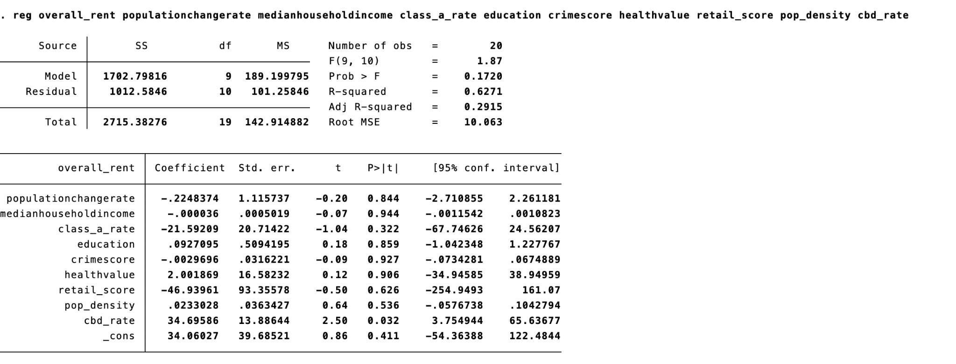
REGRESSION: overall_rent
Variables included:
overall_rent, population.change.rate, median.household.income, class_a_rate, education, crimescore, health.value, retial_score, pop_density

Slide 32
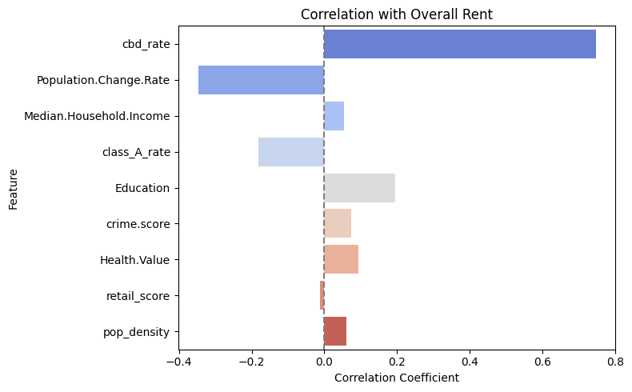
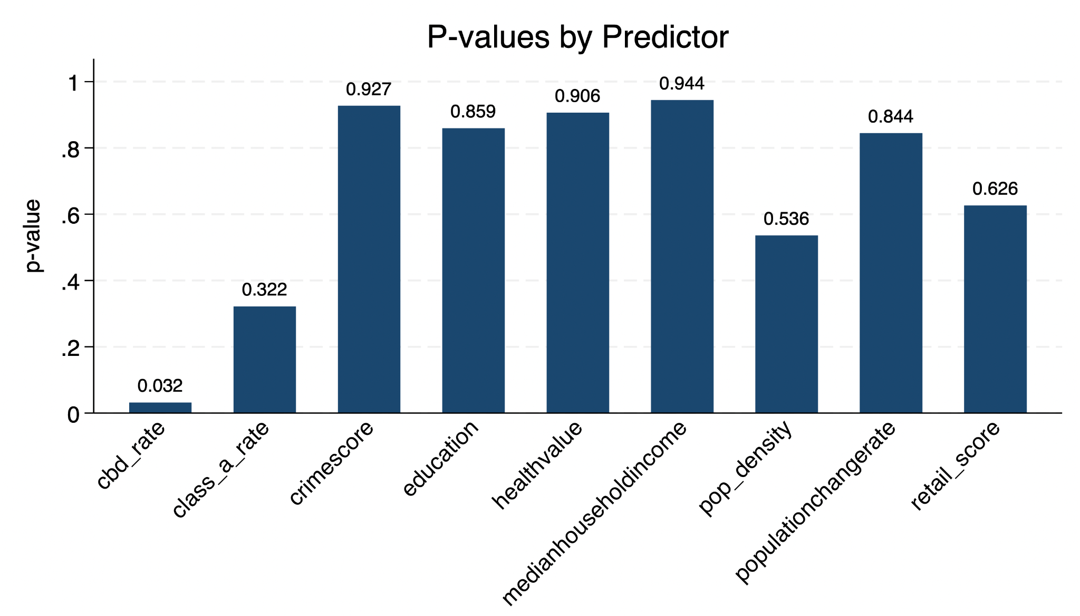
VISUALIZATION

Slide 33
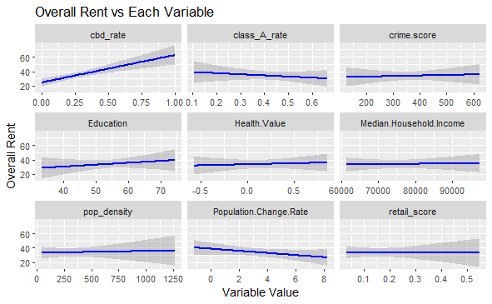
Conclusion

Slide 34
Thank you

